Slide 1

Efficient Solver for
Dynamic Puzzle Games:
Baba Is Y’all
Instructor：Jialin Liu, Ziqi Wang
Member：Xianqing Zeng, Yuhang Lin
2023/5/4

Slide 2

Content
Introduction
Background
Algorithms
Experiments & Analysis
Conclusion & Future

Slide 3


1
Introduction

Slide 4

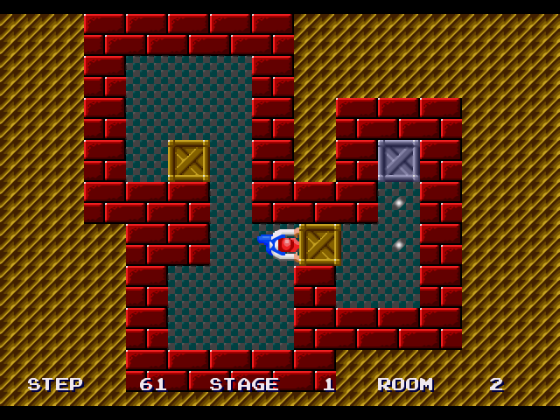
Puzzle Category
Puzzles with static rules:
2. Puzzles with dynamic rules:
Sokoban (https://gamefabrique.com/storage/screenshots/genesis/sokoban-05.png)
Monument Valley (https://img.zcool.cn/community/01e9975bc57fbba8012099c8597b77.jpg@1280w_1l_2o_100sh.jpg)
Notes:
https://www.youtube.com/watch?v=z9ptOeByLA4&ab_channel=EvolvingAILab

Slide 5


Baba Is You: Jam version
https://hempuli.itch.io/baba-is-you

Slide 6
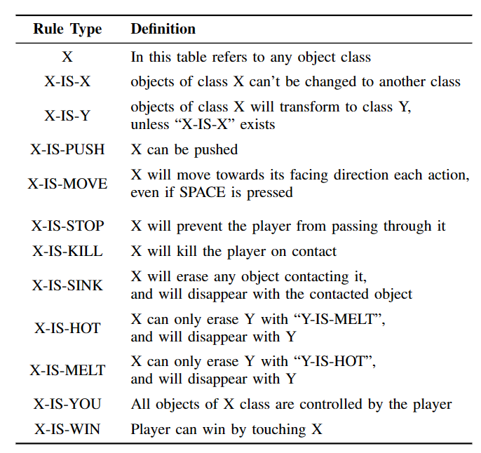
Win & Lose conditions

Slide 7
Win & Lose conditions

Slide 8
Why not have a try?
UP
LEFT
SPACE
RIGHT
DOWN

Slide 9
2
Background

Slide 10
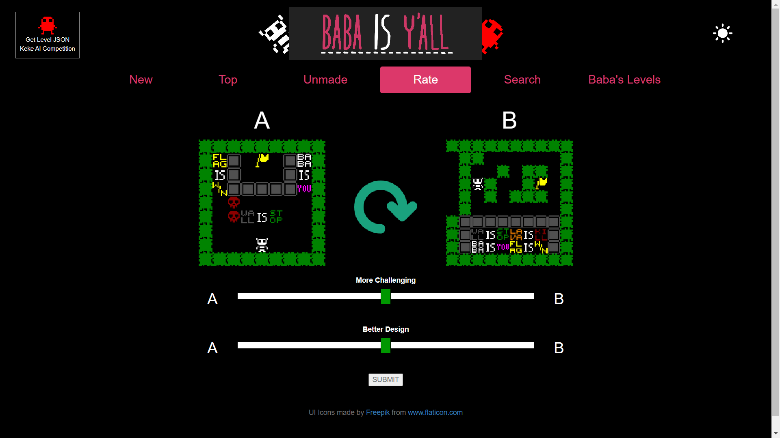
Baba Is Y’all: framework
http://equius.gil.engineering.nyu.edu/map_home.php#rate_screen

Slide 11
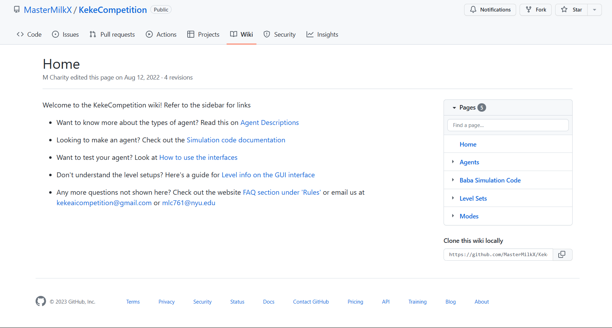
Keke AI Competition
https://github.com/MasterMilkX/KekeCompetition/wiki

Slide 12
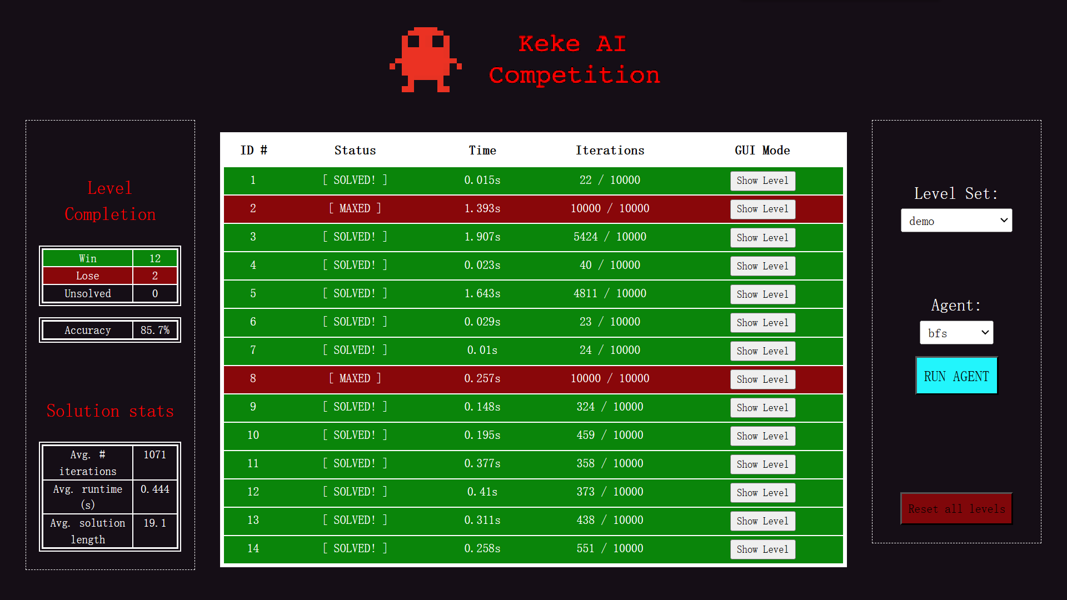
Keke AI Competition
https://github.com/MasterMilkX/KekeCompetition/wiki

Slide 13
3
Algorithm

Slide 14
Graph Explanation
↑
↑
↑
↑
↑
↑
↑
→
↑
↑
↑
→
→
→
→
→
→
→
→
→
→
→
→
→
→

Slide 15
Baseline - Random
↑
→
→
→
→
↑
↓
↑
↑
↓
→
→
→
→
→
→
↑
→
↑
↑
→
→
→
↑
↑
↓
↑
↑
maximal length = 50
←
↑
→
↓
→
↑
←
↓
→
↓

Slide 16
Baseline - BFS
↑
←
↑
→
↑
←
↑
→
→
←
←
←
→
→
→
←
←
↓
↓
↓
←
↓
→
↓

Slide 17
Baseline - DFS
↑
↑
↑
↑
↑
↑
↑
↑
↑
↑
↑
↑
↑
↑
↑
↑
↑
↑
↑
↑
↑
↑
→
→
→
→
→
→
→
→
→
→
→
→
→
→
→
→

Slide 18
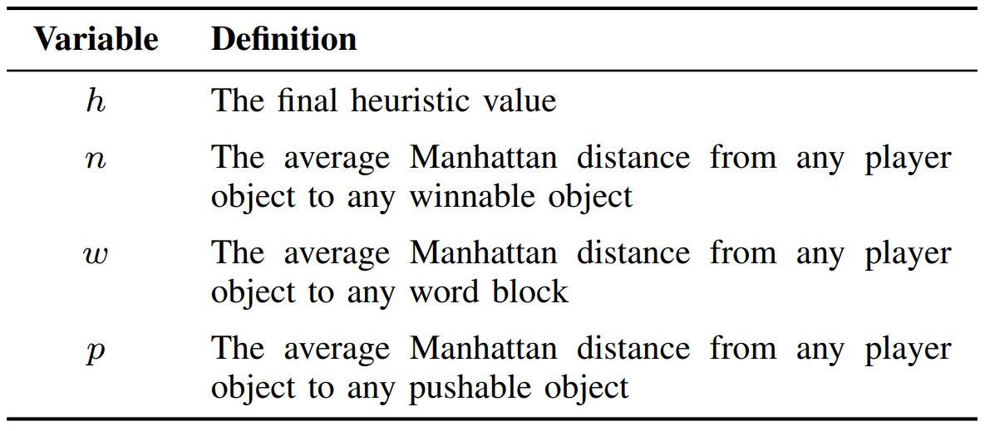
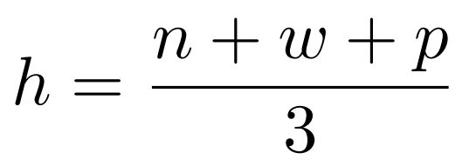
Baseline - Default
↑
→
→
→
→
→
→
→
→
→
→
→
→
→
↑
↑
↑
↑
↑
↑
↑
←
→
↓

Slide 19
Search Algorithm - RHEA
↑
←
→
↓

Slide 20
RHEA - Process
0
1
2
0
1
2
0
1
2
0
1
2
.
Step 1
4
1
2
0
1
3
4
1
0
0
1
3
.
4
1
2
0
3
2
0
2
2
4
1
0
.
0
1
2
0
1
2
0
1
2
0
1
2
.
……… fitness_1
0
1
evaluate
current_state
next_state
next_state
…
final_state
fitness
Step 2
4
1
2
0
1
3
4
1
0
0
1
3
.
……… fitness_2
4
1
2
0
3
2
0
2
2
4
1
0
.
……… fitness_3

Slide 21
RHEA - Process
0
1
2
0
1
2
0
1
2
0
1
2
.
……… fitness_1
sort & pick_best
Step 3
0
4
1
2
0
1
3
4
1
0
0
1
3
.
……… fitness_2
4
1
2
0
3
2
0
2
2
4
1
0
.
……… fitness_3
0
1
2
0
1
2
0
1
2
0
1
2
.
……… fitness_1
Step 4
pick & produce
4
1
2
0
1
3
4
1
0
0
1
3
.
……… fitness_2
next population
crossover & mutate
4
1
2
0
3
2
0
2
2
4
1
0
.
……… fitness_3
pick some best individuals

Slide 22
Search Algorithm - MCTS
↑
←
→
↓

Slide 23
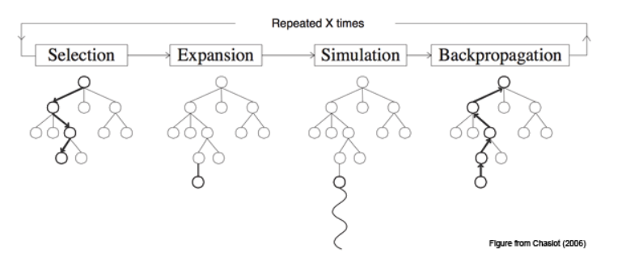
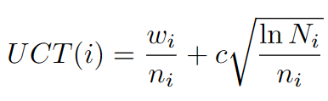
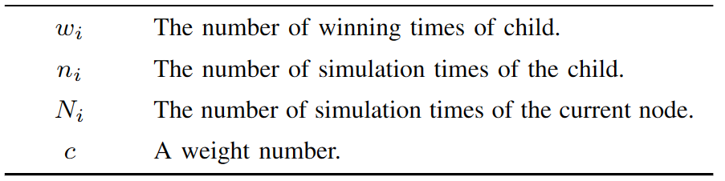
MCTS- Process

Slide 24
4
Experiments & Analysis

Slide 25
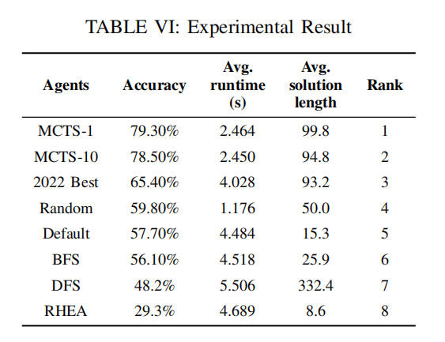
Experiments (Test cases: 246)

Slide 26
Analysis
Baseline
Own approximate accuracy
Random without search process
-> minimal runtime
BFS prefer less breath
-> shorter length and higher accuracy than DFS
Default agent with heuristic function
-> outperforms other baselines

Slide 27
Analysis
MCTS (reaches the highest accuracy)
Search efficiently
evaluates the value of each action by simulating random games rather than searching the entire game tree
Stronger exploration ability
employs random simulation to explore different decision paths extensively

Slide 28
Analysis
RHEA
Inadaptability
originally applies to general video games, emphasis on immediacy
Poor relationship between solutions
introduces new individuals randomly
parents of cross-over are still randomly generated

Slide 29
Analysis
RL (reaches the lowest accuracy)
Sparse reward problem
need to make a sequence of correct moves to achieve a goal, but rewards are not necessarily immediate
Long-term dependencies
game may require a series of specific actions to reach the goal
lack of explicit memory mechanism(LSTM)
Expensive environment interaction
env interations(JS->PY) actually spend lots of time
7 fps in practice

Slide 30
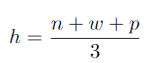
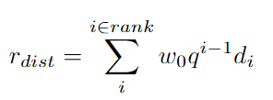
Analysis
RL Algorithms
RL
standard reward judged by single state
RL-0
desgined reward with domain knowledge
RL-d
based on RL-0
weighted distance

Slide 31
Analysis
RL Algorithms
RL
standard reward judged by single state
RL-0
desgined reward with domain knowledge
RL-d
based on RL-0
weighted distance

Slide 32
Analysis
MCTS vs RL
Balance exploration and exploitation:
MCTS implements powerful UCT policy
PPO relies on its policy update rules
Handling Sparse Rewards
better for MCTS which not relying on reward signals for search
challenging for PPO as a policy gradient methods
Long-term Planning
MCTS builds a search tree -> conducts explicit long-term planning
PPO make planning by useful value function

Slide 33
5
Conclusion & Future

Slide 34
Conclusion
First Phase
Clarified the game’s rules
configuring the game simulation environment
Run several of the given baselines agents
Second Phase
Implemented two search algorithms,
RHEA and MCTS
Do experiments among all algorithms on a full level set
Compare and analysis the results

Slide 35
Conclusion
Third Phase
Configure cross-language enrivronment and build gym env
Invoke JavaScript functions in Python
Apply DRL algorithm PPO and collect the experiment results
Compare the results of search algorithms and learning algorithms on dynamic mechanism games ‘baba is you’

Slide 36
Future
Combine PPO and MCTS (like AlphaGo)
PPO learn a heuristic policy and value function -> guide the search in MCTS
MCTS intensive search results -> train the policy network and the value network
Potential Benefit
the sample efficiency and the capacity to generalize of PPO
powerful search capabilities of MCTS

